Slide 1


Slide 2
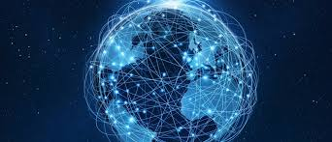
INTERNET
a vast network that connects electronic devices all over the world.
share information and communicate

Slide 3
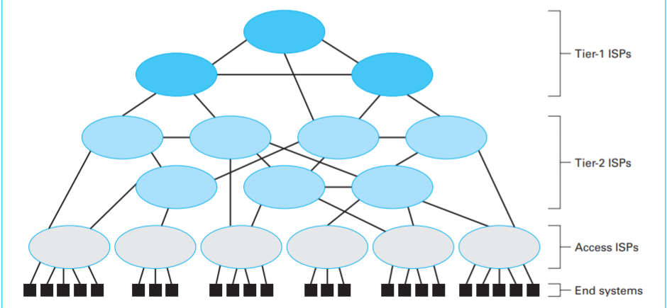
Internet composition

Slide 4
Internet 2
involves numerous universities working in partnership with industry and government.

Slide 5
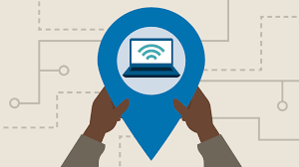
Internet Addressing
IP addresses
- domains,
-subdomains

